Slide 1
DO YOU LIKE…?
FOOD
Notes:
NOTA: per sostituire un'immagine selezionarla ed eliminarla, quindi usare l'icona Inserisci immagine per sostituirla con l'immagine desiderata.

Slide 2
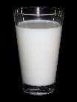
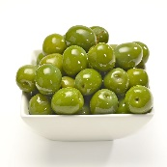
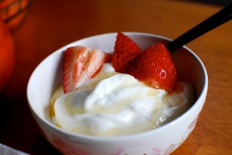
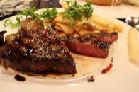
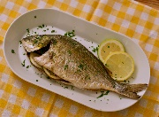
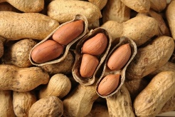
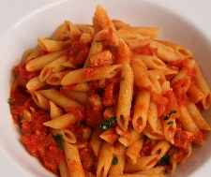
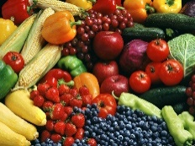
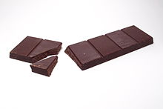
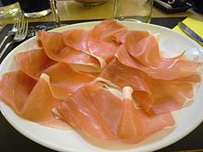
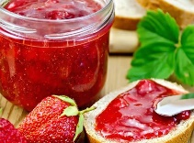
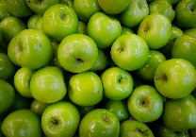
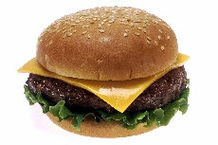
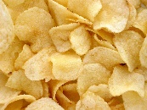
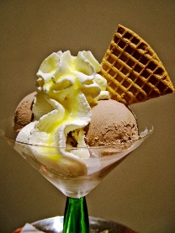
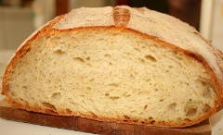
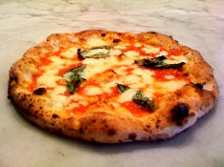
FOOD
BREAKFAST Milk Tea Coffee Chocolate Jam Honey | LUNCH Olives Pasta Ham Bread | AFTERNOON Yoghurt Peanuts Lemon Green apples Ice cream | DINNER Meat Fish Chicken Vegetables Hamburger Chips Pizza

Slide 3
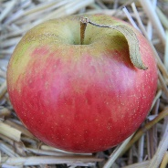
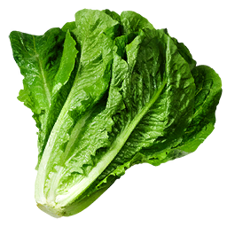
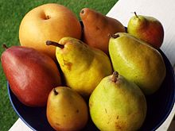
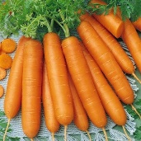
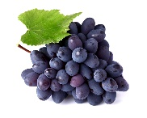
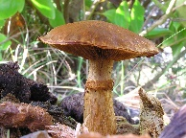
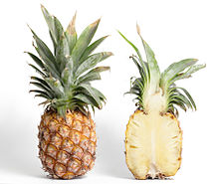
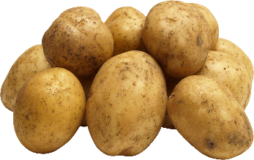
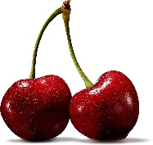
Fruits and vegetables
FRUITS APPLE PEAR GRAPES PINEAPPLE CHERRIES | VEGETABLES LETTUCES CARROTS MUSHROOMS PATATOES

Slide 4
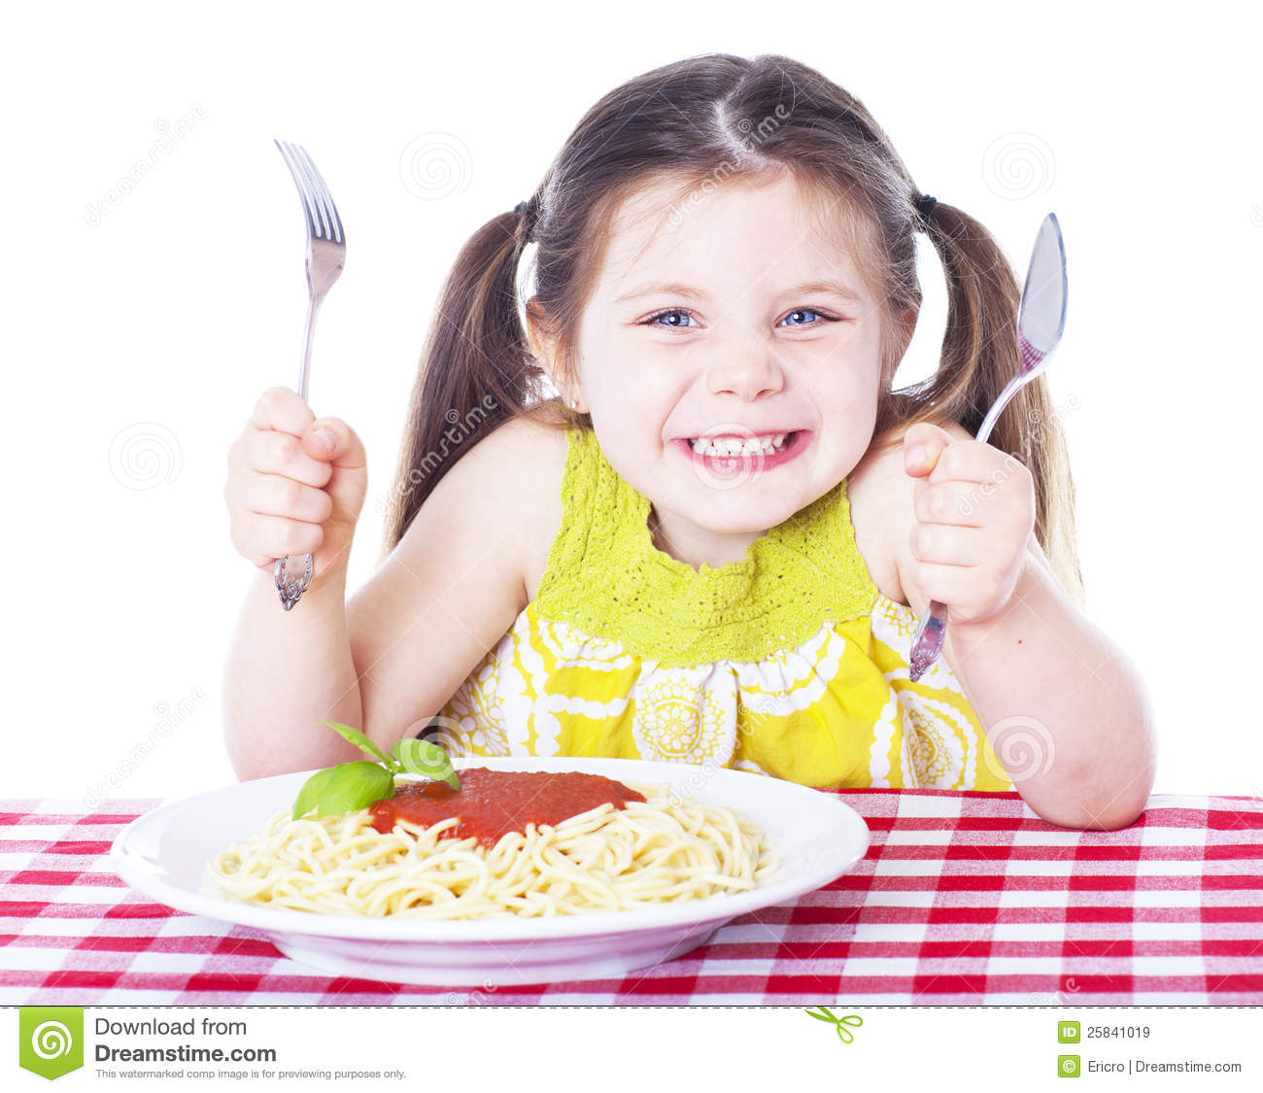
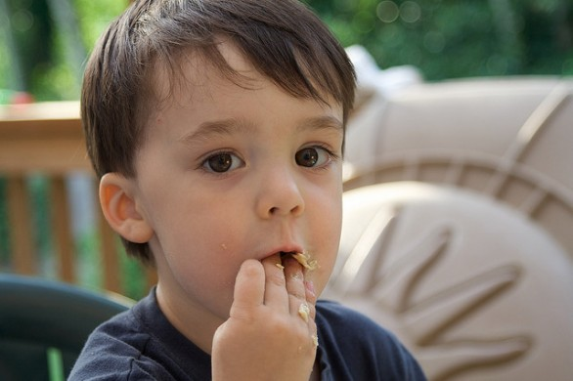
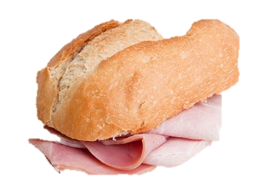
AT LUNCH…
I LIKE HAM AND BREAD!
I LIKE PASTA !

Slide 5
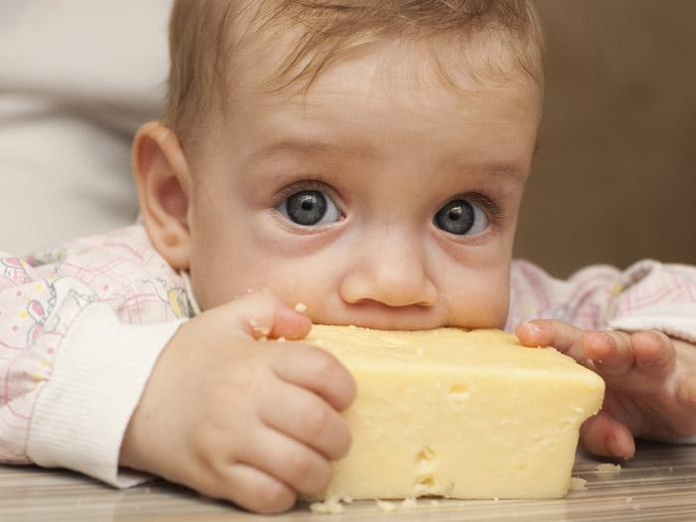
I LIKE CHEESE !

Slide 6
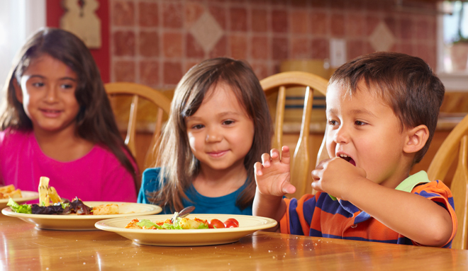
What do you like?
At dinner…
We like pizza !

Slide 7
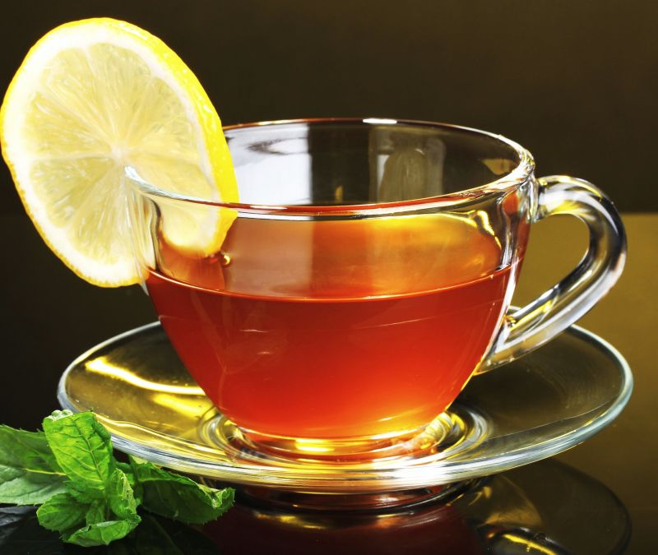
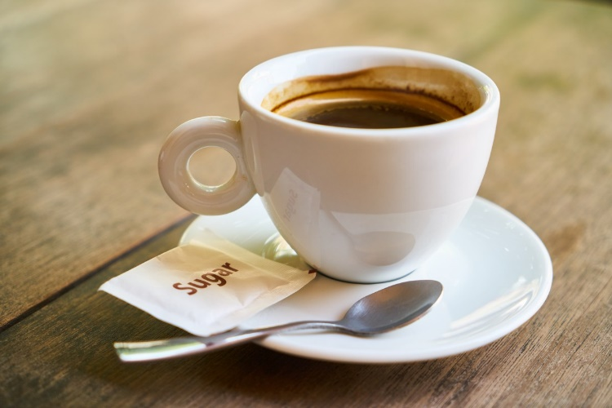
coffee
IN THE AFTERNOON
I DON’T LIKE…
tea

Slide 8
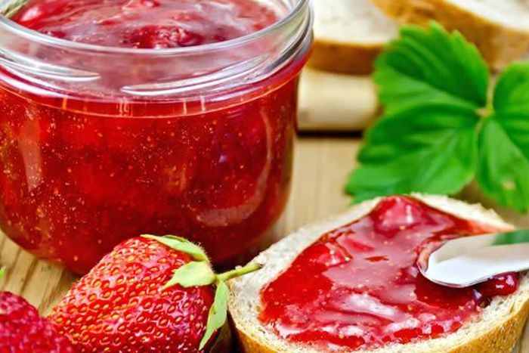
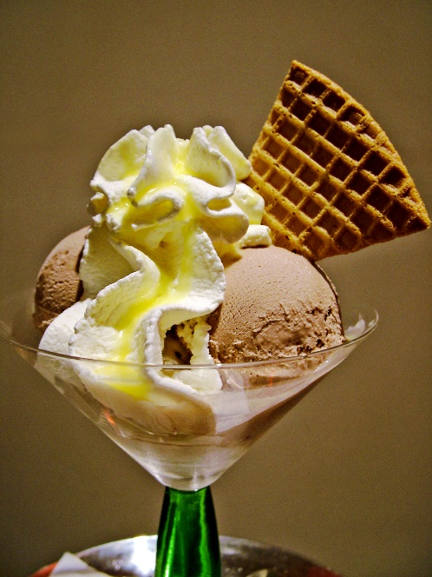
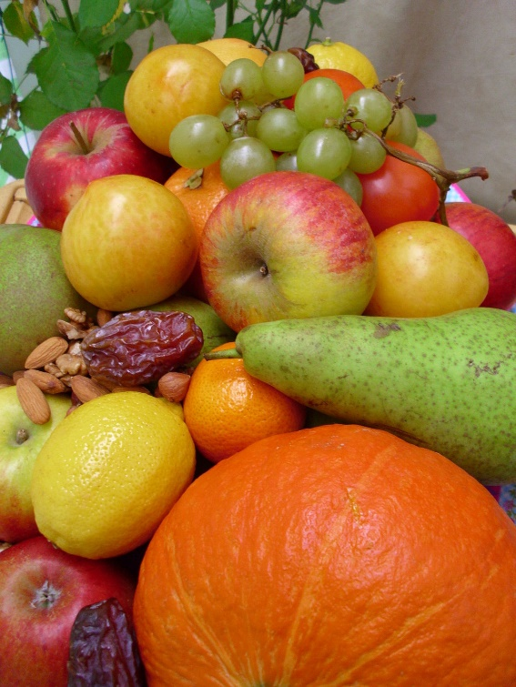
JAM
IN THE AFTERNOON
I LIKE…
ICE CREAM
FRUITS

Slide 9
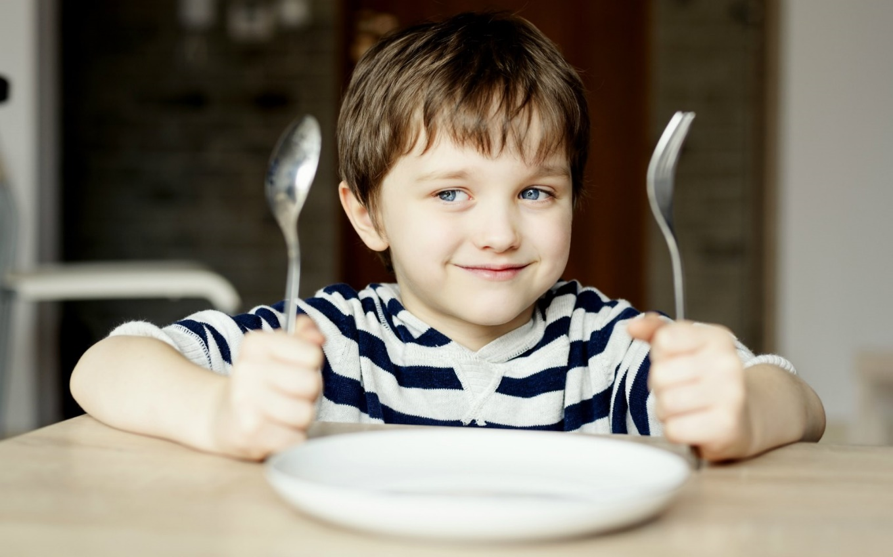
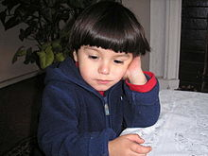
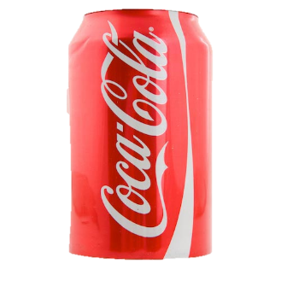
I LIKE COKE!
I DON’T LIKE WATER…..

Slide 10
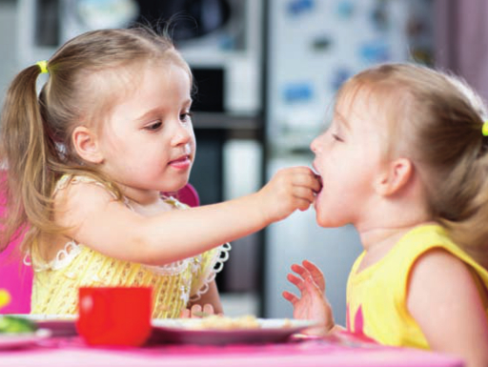
AT BREAKFAST…
YES I DO !!!!
IT’S MY FAVOURITE FOOD
DO YOU LIKE MILK AND CHOCOLATE?

Slide 11
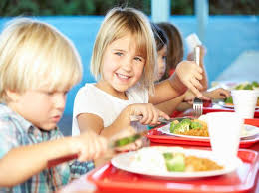
AT LUNCH…
NO,
I DON’T !!!!
I HATE BROCCOLI !
DO YOU LIKE BROCCOLI?

Slide 12
GRAMMAR …
I LIKE ICE CREAM MI PIACE IL GELATO
I DON’T LIKE MUSHROOMS NON MI PIACCIONO I FUNGHI
I HATE BROCCOLI IO ODIO I BROCCOLI
DO YOU LIKE SPAGHETTI? TI PIACCIONO GLI SPAGHETTI?
YES, I DO. SI
DO YOU LIKE OLIVES? TI PIACCIONO LE OLIVE?
NO, I DON’T NO
WHAT DO YOU LIKE? COSA TI PIACE?
MY FAVOURITE FOOD IS CHICKEN AND CHIPS
IL MIO CIDO PREFERITO E’ IL POLLO E PATATINE

