Slide 1
III A Plesso Rodari

Slide 2
Mother’s Day is celebrated all around the world. In Italy, it is celebrated on the second Sunday, in May; in the United Kingdom the fourth Sunday of Lent

Slide 3
Learn and copy on the copybook Special day Mummy, my darling you love me and I love you. You are the best in every day of the year. Happy special day

Slide 4
On the workbook copy and complete About my mummy My mummy’s name is……… Her surname is…… She is………..years old. She has got …….. (colour)hair and…( colour)eyes. Her favourite colour is… Her favourite food is… She has got a ….(colour) dress and ….(colour) shoes.

Slide 5
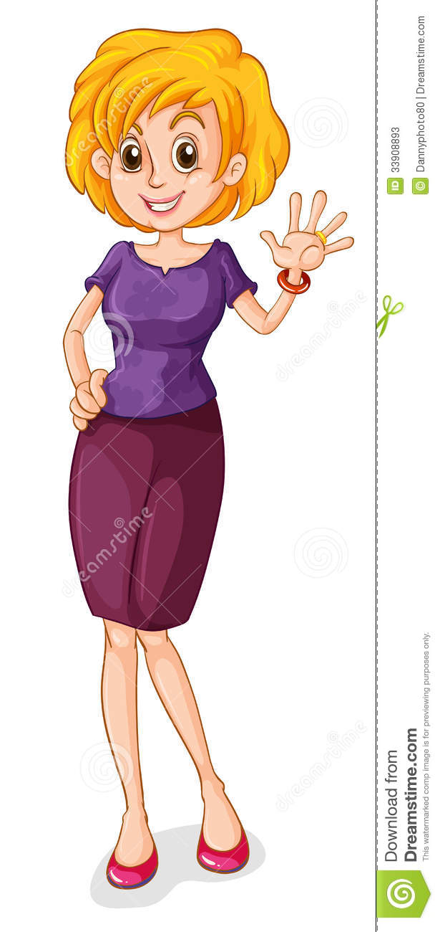
On the copybook
Draw and colour your mummy.

Slide 6
Listen this song “I Love My Mommy “ I love my mommy, I love my mommy I love my mommy, yes I do.' Here's a kiss and a hug for you Thank you mommy for all you do Happy Mother's Day, Happy Mother's Day 'Happy Mother's Day, I love you.' I love my mommy, I love my mommy I love my mommy, yes I do. Here's a kiss and a hug for you Thank you mommy for all you do Happy Mother's Day, Happy Mother's Day Happy Mother's Day, I love you. Happy Mother's Day, I love you. link: https://www.youtube.com/watch?v=A014gTIAeng

