Slide 1
I DON’ T LIKE
I LIKE
Classe 4D Ins. Anna Toscano

Slide 2
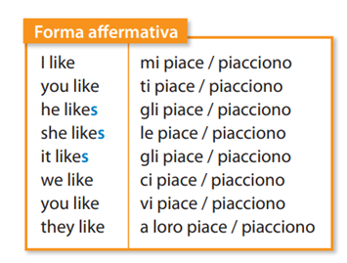
Simple Present

Slide 3
Verbo TO DO – Verbo FARE
I do I do not I don’t
You do you do not you don’t
He does he does not he doesn’t
She does she does not she doesn’t
It does it does not it doesn’t
We do we do not we don’t
You do you do not you don’t
They do they do not they don’t
REMEMBER
Ai verbi che finiscono con
S-SS-O-SH-CH-X-Z
si aggiunge ES alla terza persona singolare

Slide 4
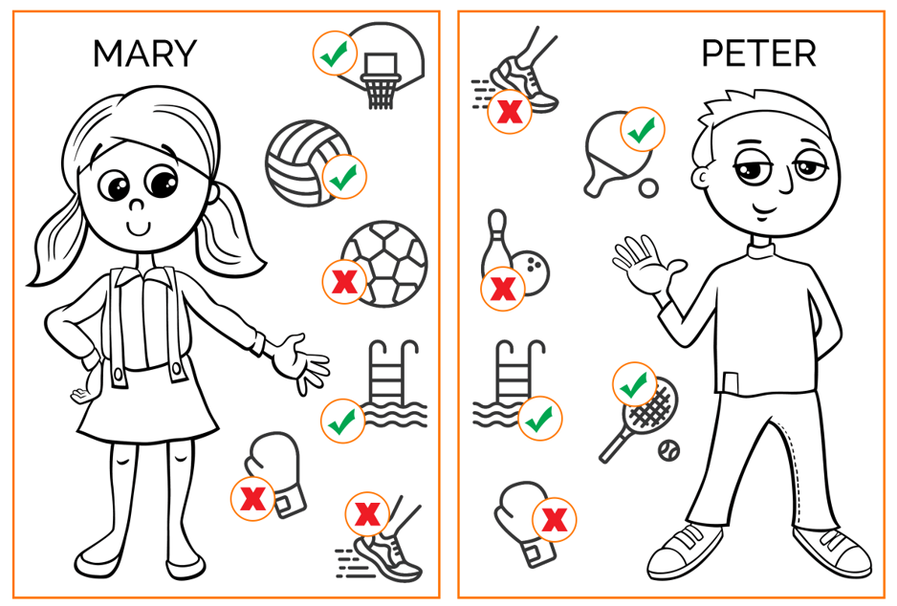
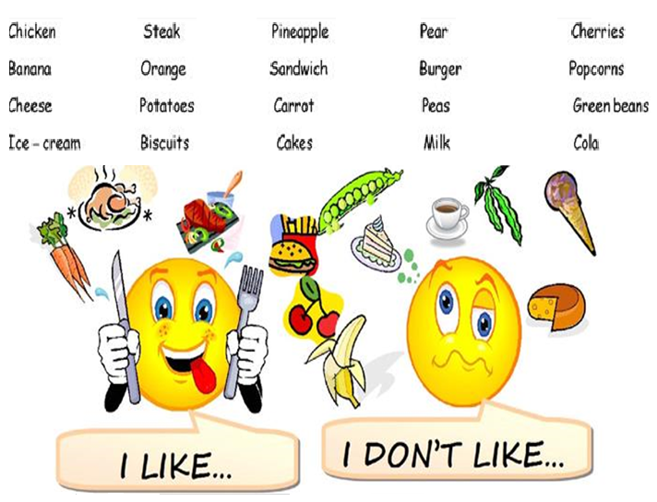
Football, tennis, volleyball, bowling, basketball, boxing, swimming, running.
EXAMPLE
Mary likes basketball Peter doesn’t like bowling
ACTIVITY

Slide 5
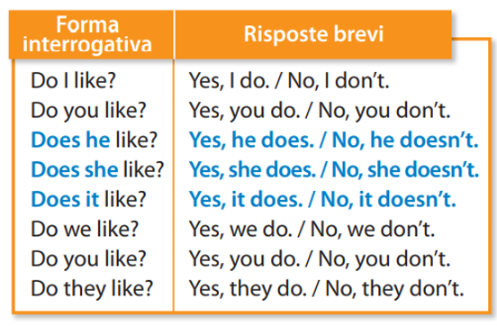
Do you like milk? Ti piace il latte?
Yes, I do Si, mi piace
No, I don’t No, non mi piace
Does she listen? Lei ascolta?
Yes, she does Si, lo fa
No, she doesn’t No, non lo fa

